Slide 1
Workshop 4:
Introduction to Git and Github
By Jolene

Slide 2
Pre-Event Preparations
Code Editor/IDE
VS Code
Atom (need to download plugin for terminal/ just use command prompt)
Download Git https://git-scm.com/downloads
Of course, a Github Account
These slides for your reference:
https://github.com/nyp-lit/webdevcourse2022
Notes:
Here’s what we will need today. Let me know if youve downloaded by typing yes into the chat, we wait till well have quite a few responses b4 we start
Send into the chat:
here’s the link to all workshop materials:https://github.com/nyp-lit/webdevcourse2022

Slide 3

Contents
1
Photo-taking + briefing
How Git and Github Works
Git Basics (push/pull etc)
Git History and Branches
Github Basics
Publishing to Github
Attendance & Feedback Form

Slide 4
Git Commands and Workflow

Slide 5


Why Git and Github?
Git and Github are important things to know how to use especially when working in teams.
Cloud-based hosting service to manage Git repositories
Version Control System
Notes:
Git is a version control system that lets you manage and keep track of your source code history. GitHub is a cloud-based hosting service that lets you manage Git repositories. For example its great when you’re working with a team on the same code, incase someones local code is broken or lost somehow they can restore it to how it was initially with version control.
we want to understand what the commands are actly doing instead of memorising the commands instead of js sending zipfiles to each other we can instead collaborate with github n git

Slide 6
Understanding Git
Local Repositories vs Remote Repositories?
Remote Repository
Local Repo
Local Repo
Local Repo
user 1
user 2
user 3
Notes:
remote repository
- storage area for code/files etc
- local repository means ur own ver of the code on ur own laptop
- make changes on ur own comp and push changes to the remote repository
- if the remote repository has additional changed than ur local repository u need to pull before u can push again
- push to repo to share ur code with everyone and to get shared code thts updated u can pull frm repo

Slide 7
Understanding Git: History and Branches
What are commits?
Commits
After making changes to the code you pulled from the remote repository, you want to add those changes to the remote repository
You commit the changes, which marks a checkpoint
Git stages those changes
You push the code to remote repository so that everyone can view it

Slide 8
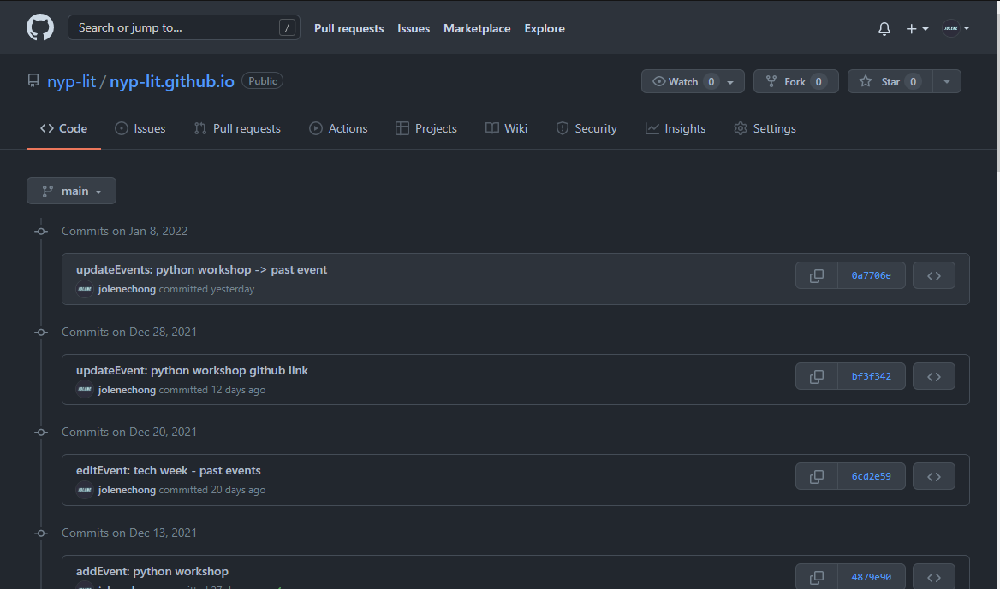
Understanding Git: History and Branches
Notes:
If we look here as an example, for the NYPLIT website Each commit to git stores information like time, comments and who pushed the code
This is an example of the commits i did with git which u can easily see using github
Its actly the commits for our nyplit website!

Slide 9
Understanding Git: History and Branches
What are branches?
Branches are copies of the repo at the time you created the new branch
For example, there’s new features you’re working on but there are bugs in the code that you want to share with your team to help debug
You don’t want to push it to the master branch
We try to keep the master branch with working, finalised code
So you create a new branch and commit to the new branch, after debugging you can merge this to the master branch
new branch
commit 2
commit 1
commit 3
Notes:
branches -> copy of repo at a certain point of time (nt done but uw to work on it tgt)
branches -> for new features from the first master branch u make a new branch and add features in case ur feature doesnt work yet den once ure sure its working u can merge the branches which will add ur feature into the master branch w all the shared working code

Slide 10
Understanding Git: History and Branches
How do commits and branches come together?
New branch with commits
commit 2
Other commits
commit 1
commit 3
Merge branch back to main branch
Notes:
git history and branches
github's main role is to track a history of commits
aft making changes on ur own local machine u can bundle everyth up, like a checkpoint den u can commit
u make a commit with a command
if u mess smth up in the codebase u can come back to this time to see what was changed -> esp if code is valuable
push -> merge in current code and what changed
pull -> pull changes from remote repo, gives u new commit since u last pulled, merge to local machine
github helps to track all commits
master branch
- we will make sure that this is alws working
- try nt to push to master unless ure sure its working
we can commit to other branches
To better understand lets start creating repos

Slide 11

Setting up Git
Configuring name and email
Ignore ‘$’, it just means everything after that is a command
Make sure to enter your own name and email address.
Notes:
Make sure git is alr installed if nt the command won't be recognised
Send into chat
git config --global user.name "Your name here"
git config --global user.email "your_email@example.com"
git config --list

Slide 12
Setting up Git
Check settings you just configured
To list configurations
Notes:
Send into chat
git config --list

Slide 13
Using Git in Command Prompt/Terminal
Initialising local repositories
git init
Whatever folder you’re in will become a git repository
Now anything inside of it will be tracked by Git
There will also be a folder formed called .git (don’t delete this)
git add readme.md
Adds a readme.md file to your repo
It is good practice to have a readme file with details on how to use/run your project and what your project is about
This command used to add/stage specific files, to add all files in current directory you can use git add .
Notes:
Send into chat
Can check out https://github.com/jolenechong/FullstackForum#readme for examples of what you should have in your readme
If you get fatal: not a git repository means you’re likely in the wrong folder or you havent initialised the git repository

Slide 14
Using Git in Command Prompt/Terminal
Checking Staged Changes
git status
Used to show which branch you in and what are the changes you staged initially using the “git add filename.txt” command
All this changes will not be added to the repo until u commit and push changes
git commit -m “comment here”
This command is used to commit all staged changes
Comments should be descriptive as good practice
Try git status again after committing changes to see that all stages have been committed
Notes:
You can also use git reset file to unstage changes you added

Slide 15
Using Git in Command Prompt/Terminal
Commands for Branches
git checkout -b new_branch_name
Used to create new branches
Any changes on new branch will not happen in master branch, change back to master branch
git checkout master
Code in the folder/files you’re in will change to what it was in master branch automatically
git merge newfeature
Merge newfeature branch with the current branch you’re on

Slide 16
What if you want to revert a commit?
Did something wrong and introduced a bug on accident?
git reflog
Used to view the id of all past stages commits
Basically a undo history for repo
q to quit
git reset 34234H3
Unstage changes back to the id 34234H3
Do git reset –hard 34234H3 to get your local repo back to how it was <- more dangerous
Notes:
So that’s all we need to know for git, lets try it out with practical now,, you can open your vscode/atom and let me know in the chat when youre ready
Create index.html
Initialise folder w git init
Create README.md
Git add readme
Git add .
Write “Using Git and Github” p tag in master branch
Create new branch called newfeature -> git checkout -b newfeature
Write ‘feature branch” p tag in newfeature branch
git checkout master -> see tht feature branch nt there
Go back to newfeature see its the den come back
git checkout master
Git merge newfeature
Write “Undo this paragraph” to index.html
Git add and Commit index.html
Git reflog
Git reset
Git reset –hard

Slide 17
Quiz Time
Notes:
https://www.menti.com/pu7spuiw3r

Slide 18
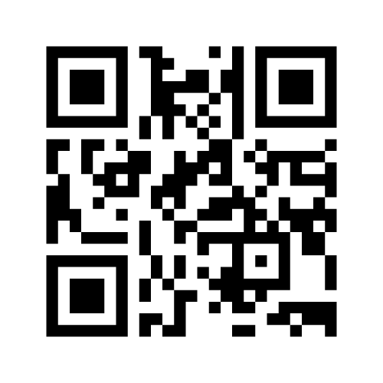
Quiz Time !!
Scan this QR code or click the link we sent in the chat!
https://www.menti.com/pu7spuiw3r

Slide 19
What’s next?
There are many more commands that we haven’t and won’t be covering but those covered in this workshop is more than enough for normal usage in Github and Git. You’ll just need to google when you need more commands/encounter errors.
Notes:
5min break
remote repos
- start repo on github
- link local repository to remote repository
- push changes to repository
- dont copy exact
- explain wats alr thr
map the word origin to the url
git push origin main -> pushes everyth now to main branch
git push -u origin main -> means doing git push will alws do the same thing

Slide 20
Git and Github, Remote Repositories
Notes:
For this part, follow along

Slide 21

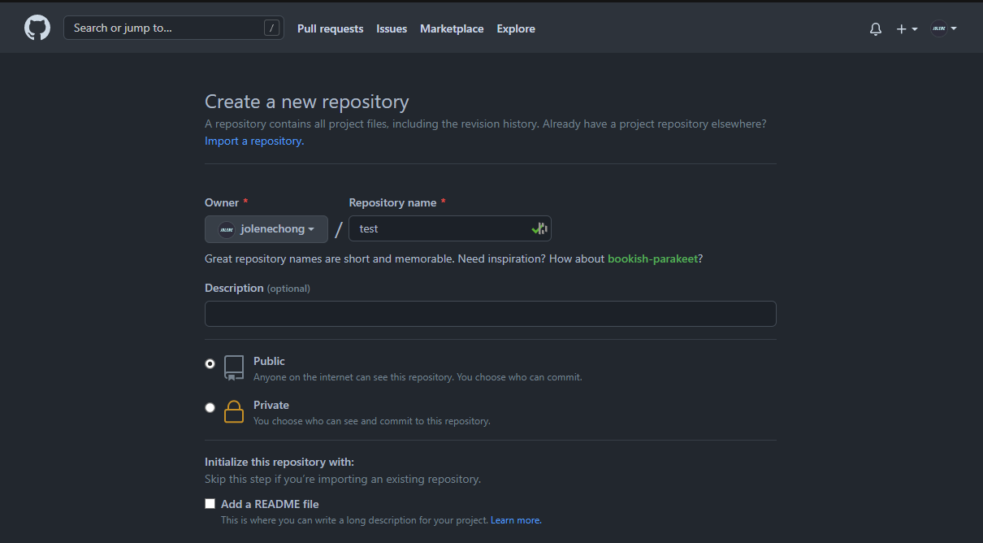
What about remote repositories?
Remote repos using Github
Open New repository on Github
Enter name of repo, create repository
Notes:
Ask chat if want to take a break
remote repos
- start repo on github
- link local repository to remote repository
- push changes to repository
- dont copy exact
- explain wats alr thr
map the word origin to the url
git push origin main -> pushes everyth now to main branch
git push -u origin main -> means doing git push will alws do the same thing

Slide 22
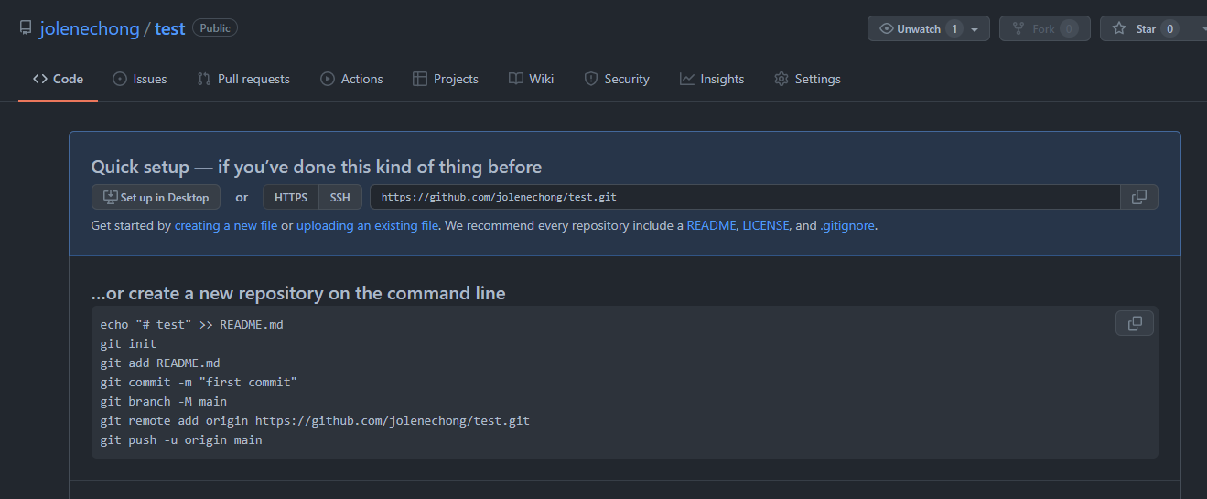
What about remote repositories?
Remote repos using Github
Notes:
If you’re familiar with command prompt you would know the first command echo test to readme means you’ll add the phrase #test into a readme.md file
Then git init is to inisitalise repository, git add . to add all files in current directory and then choose the branch as ur main/master branch
git remote rm is used to delete remote repositories
git remote -v used to view remote directory
others for troubleshooting: https://docs.github.com/en/get-started/getting-started-with-git/managing-remote-repositories

Slide 23
What about remote repositories?
Remote repos using Github
git remote add origin https://github.com/user/repo.git
Means you’re setting the remote repository and mapping the word “origin” to the link so that everytime you push to “origin” it will push to that remote repository
git remote rm origin
Removed the remote repository tied to “origin” that you just set
Other Info you might find useful for troubleshooting: https://docs.github.com/en/get-started/getting-started-with-git/managing-remote-repositories
Notes:
git remote add origin git remote add origin https://github.com/jolenechong/test.git means ure setting the remote and mapping the link to origin so that everytime you want to push it you can just use the word origin and they will know what link to push it to
git remote rm is used to delete remote repositories
git remote -v used to view remote directory
others for troubleshooting: https://docs.github.com/en/get-started/getting-started-with-git/managing-remote-repositories
If that doesn’t help, feel free to drop a msg in the chat and lmk what error you’re experiencing.

Slide 24
Using Github
Notes:
More about issues, pull requests, managing access, github pages, git ignore etc
Editing files here means you’re editing the remote repository means the next time you try to push to this repo you will first need to pull becuz there are new commits that you didnt get on you local repository from remote repository

Slide 25
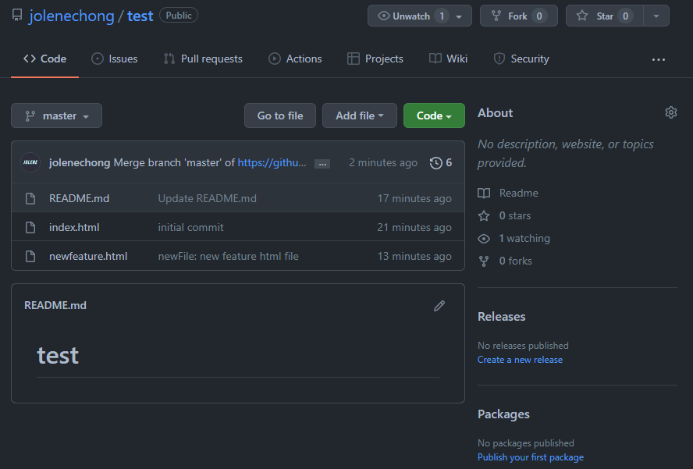
How to use Github
What does it look like in Github?
Notes:
We can see since we merged the branches of newfeature into master, in our master branch we can se the newfeature file
You can switch branches to see what the other branch has

Slide 26
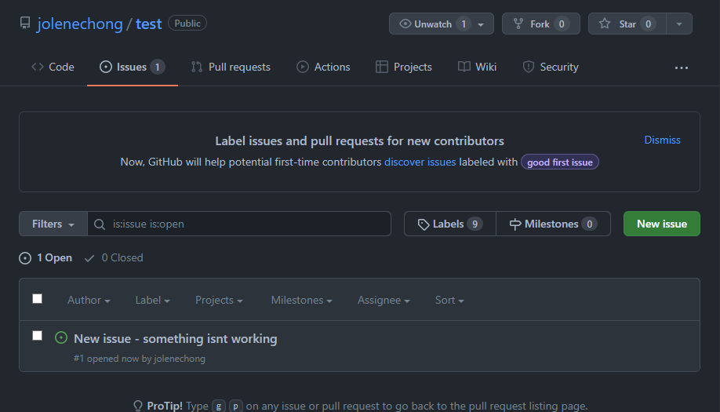
Open Source and How it works
Issues
Notes:
For example if you wanted to open source a project, which means ____
So people who use the program might experience some errors on their end
So they let you know of these errors by creating issues

Slide 27
Open Source and How it works
Pull Requests
Pull requests let you tell others about changes you've pushed to a branch in a repository on GitHub. Once a pull request is opened, you can discuss and review the potential changes with collaborators and add follow-up commits before your changes are merged into the base branch.
Let’s take a look at a popular repo to see how this looks.
Notes:
https://docs.github.com/en/pull-requests/collaborating-with-pull-requests/proposing-changes-to-your-work-with-pull-requests/about-pull-requests
https://github.com/AppFlowy-IO/AppFlowy

Slide 28
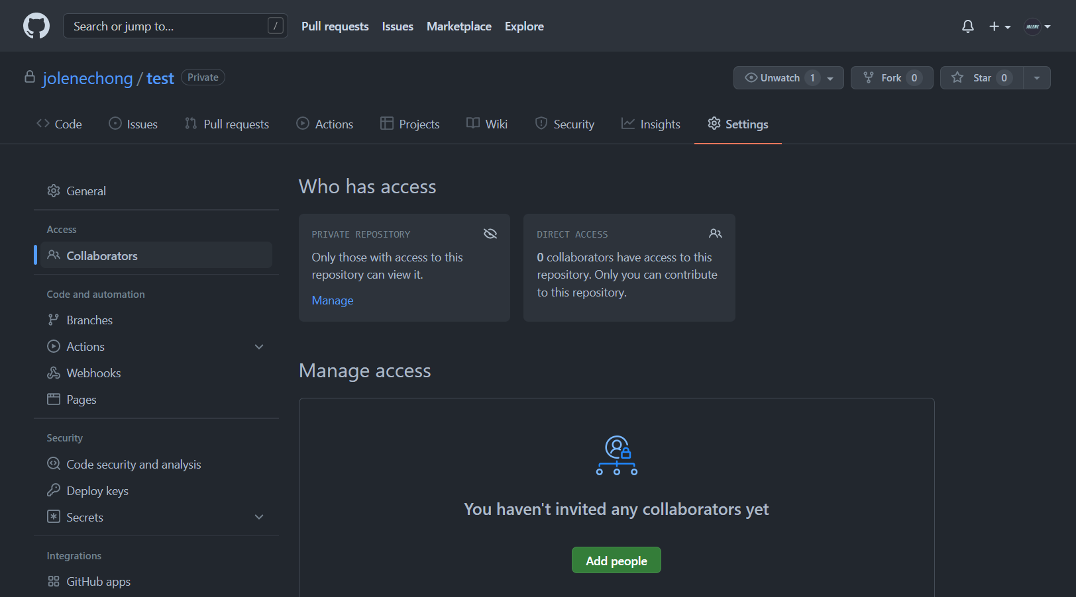
Open Source and How it works
Managing Access
Notes:
Choose who you want to allow to push to your remote repository

Slide 29
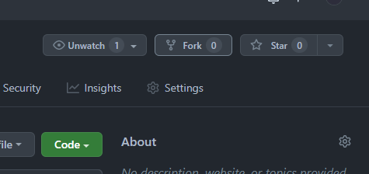
Open Source and How it works
See someone’s open source project you’d like to work on?
Fork repositories
Get the current version of their remote repository on github
Will create your own repo where you can edit etc.
Notes:
Choose who you want to allow to push to your remote repository

Slide 30
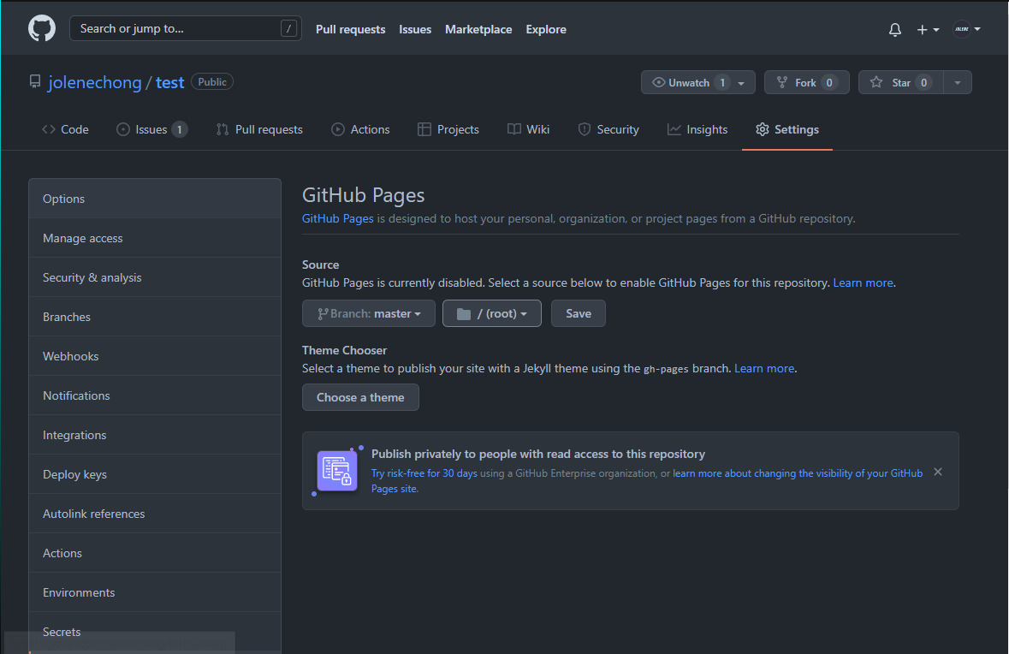
Publishing your website on Github Pages
Github Pages
Notes:
Choose the branch you want to publish whis is most likely the master branch and save

Slide 31
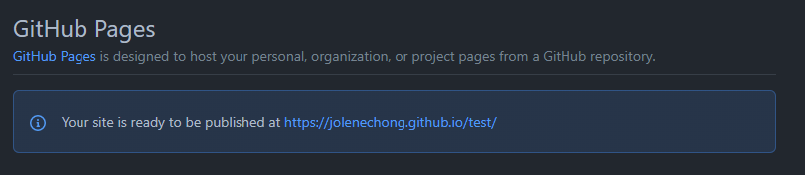
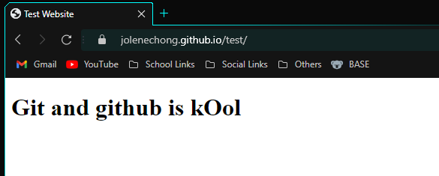
Publishing your website on Github Pages
Github Pages
That’s all! After you save this will show up, wait for awhile and click on the link. You can now share this link with anyone in the world to view your website.
Notes:
Choose the branch you want to publish whis is most likely the master branch and save
More complicated if you want to publish reactjs sites, i still hv no clue how to
Instead its much easier to use netlity for react sites
Another thing is that if your indexx.html file is not at root directory in the remote repository github pages most likely wont be able to find it and it will just show you the readme file instead

Slide 32
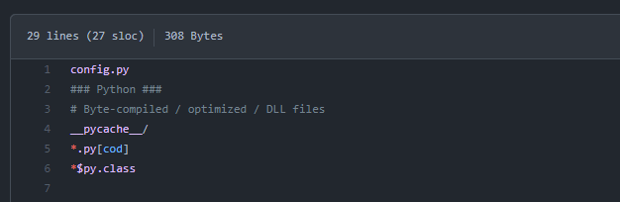
Publishing your website on Github Pages
What if you have files you don’t want to share?
Let’s say for the upcoming hackathon you want to use an API which requires API keys.
You know that you can’t share API keys, so how can you publish this?
Using .gitignore files!
Notes:
Add a new file to your repo and name it .gitignore (no file extensions)
Add the file name config.py in it
What .gitignore does is that git ignores all folders names pycahe -> esp useful if you use pycharm and ignores whatever files you ask them to within this gitignore file
Here i put config.py in it and in my config.py file i will put API_TOKEN = ‘apitoken_here’
Then i can reference the token when needed by doing a from config.py import API_TOKEN
https://www.toptal.com/developers/gitignore

Slide 33
Future Learning: Github
Other than Youtube with lots of good videos teaching you about using Git and Github, Github also has its own lab tutorial which you can follow through to learn how to better use Github. And a cheatsheet for git from github.
https://lab.github.com/githubtraining/introduction-to-github
https://education.github.com/git-cheat-sheet-education.pdf
Notes:
https://lab.github.com/githubtraining/introduction-to-github
https://education.github.com/git-cheat-sheet-education.pdf

Slide 34


Thank you!
Do you have any questions?
Hop over to the get-support voice channel! We will be there till the end of the event, or feel free to drop us a message in get-support text channel
https://nyp-lit.github.io/
@nyp_lit

